Slide 1
Major Forum Actuarial Science Club
Fall 2023
Chad Stein and Srikar Sunil

Slide 2
Club officers
Officer | Position
Mandy Hammell | Head of Actuarial Science Program
Chad Stein | President
Srikar Sunil | Vice President
Justin Morrison | Director of Corporate Outreach
Angelina Krebs | Director of Communications
Quinn Egal | Director of Finance
Anthony Padula | Director of Technical Workshops & Databases
Roshan Shah | Director of Student Development
*Feel free to email officers - contact information on psuactsci.com

Slide 3
Agenda
1
2
3
4
Upcoming Events and Meetings
Relevant Statistics
Changes Occurring
New Students to Actuarial Science

Slide 4
Upcoming events
Aug 28th – Sept 10th:
Information Sessions
Aug 31st:
Resume Review & Professional Development
Sept 1st:
Bootcamp Registration
Sept 5th:
Bootcamp Kick Off
Sept 6th:
Resume Review 2
Sept 11th:
Career Fair
Sept 12th:
In-Person Interviews
Sept 20th:
Student Mentorship Kick Off
Sept 27th:
Alumni Mentorship Kick Off
For more information, please check out the website: psuactsci.com

Slide 5
Key Statistics
Salary, Internship and Full Time Positions, and Actuarial Exams

Slide 6
Key statistics from our program
Salary Insights
Exams Passed
Positions Filled
Full Time
Median: $75k | $5k
Upper: $100k | $7.5k
Internships
Median: $25 /hr.
Upper: $40 /hr.
Total: 64 Exams
Unique students: 39 students
Average Currently: 1.6 ≈ 2 Exams
Upper Currently: 4 Exams
Average at Graduation: 3 Exams
Full Time
Total: 95% placement (2023)
Internships
Total: 55 (2023)
** These figured are derived from current Penn State students and alumni
Notes:
Ask if students are interested more in how salary is derived full time and how to max it out straight out of college

Slide 7
Top Sponsors
Existing
Recently Added in 2023

Slide 8
Where are students going for jobs?
Internship
Full Time
Top Hiring Companies
Aetna¹
Cigna¹
Prudential¹
Highmark¹
Deloitte
Transamerica
Resolution Life
MetLife
Top Hiring Companies
Aetna¹
Cigna¹
Prudential¹
Erie Insurance¹
Munich Re¹
Lincoln Financial Group
Milliman
MetLife
Highmark¹
Footer: ¹ Top Sponsor of the Club

Slide 9
Changes Occurring
Dues and Exam Reimbursements

Slide 10
Dues changes
Now only $50 one-time fee
Allows financial benefits of the club including:
Exam Reimbursements
Study Material Discounts
No fees required for all events, Career Fair, all programs including bootcamp and student/alumni mentorship
Students grandfathered in (no required payments)
Juniors and Seniors
Discounts
Bootcamp participants get $10 off
Sophomores (during 2022-2023) who paid dues last year $20 off

Slide 11
Exam reimbursement changes
 | P | FM | SRM | FAM | MAS-I | MAS-II | PA | A-LTAM/STAM
Standard Tier | 50 | 50 | 75 | 75 | 100 | 100 | 100 | 100
Platinum Tier | 200 | 200 | 250 | 250 | 350 | 350 | 350 | 300
Standard Tier: (0-5 Attendance Points)
Platinum Tier: (6+ Attendance Points)
For Fall Semester
Info Sessions = 0.5 points, all other = 1 point
Student Mentors = 2 points, Associate = 3 points, Director = 4 points
Required attendance points for spring semester will be lower

Slide 12
For New Students
How to become more involved and learn more about the profession

Slide 13
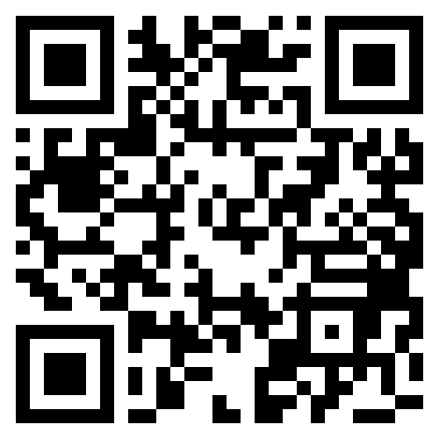
Club website
Great resource for profession, program, or club questions
Includes club officer’s email to reach out to us
Please do if you need help or have questions!
Our website is known to be the best for actuarial programs in the US!

Slide 14
New students to the actuarial profession
We recommend you participate in the bootcamp occurring this semester, Fall 2023
Cost $10
Material Covered:
Background of profession
Paths to choose
Success
Multitude of benefits
Pipeline to getting internships and jobs
Recognition in resume book
Great way to meet other students in the program
Students who graduate bootcamp automatically get platinum attendance
Anyone who did not participate last year can apply!

Slide 15
Interested in being a part of the board?
Positions available:
Junior and Senior Year Positions
Freshman and Sophomore Positions
These positions:
Are flexible
Allow for first choice on Director and Assistant Director Positions
Give attendance points to receive platinum attendance
*These are great opportunities to get involved in the club and use the skills gained for internships

Slide 16
Discussion & Questions

