Slide 1
Resume Workshop
The Pennsylvania State University
Actuarial Science Club
August 2017

Slide 2
Agenda
Sign In & Drop Off Resumes
Resume Breakdown
Additional Resources
Resume Review

Slide 3
Is Your Resume Ready?
If not, you are in the right place
Focus on Actuarial Specific Resume Building
General Help Resources
Penn State Career Services
Smeal Career & Corporate Connections (114 BB)
Office of Science Engagement (124 Ritenour)
Purpose
Structure
Example
Tips

Slide 4
Purpose of the Resume
Highlight Relevant Details
Don’t Over Explain - Elaborate in Interview
Practice Your Pitch
30 – 60 Seconds to Make Impression
Show Value to Employer
Ask Yourself “Why Should They Care?”
Purpose
Structure
Example
Tips

Slide 5
Structure of an Actuarial Resume
I.
Title
II.
Education
III.
Exams & VEEs
IV.
Relevant Work Experience
V.
Leadership & Activities
VI.
Skills & Honors
VII.
Additional (Interests/Hobbies, etc.)
Purpose
Structure
Example
Tips

Slide 6
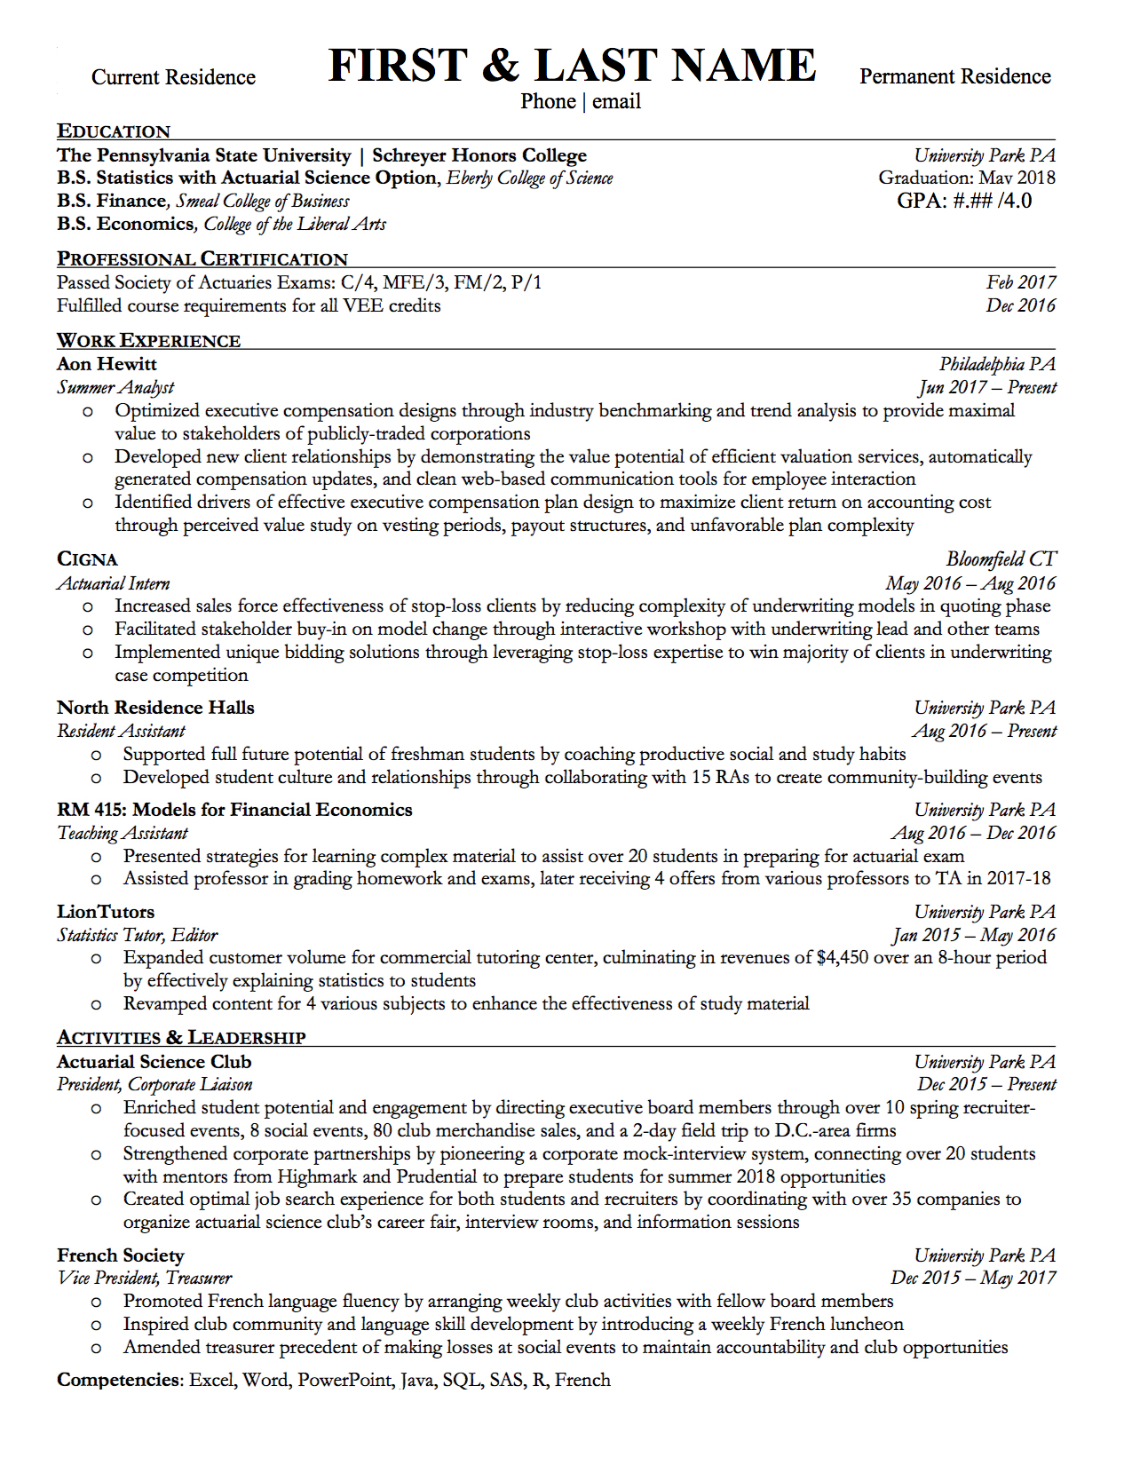
Resume Walk Through
How Does Your Resume Differ?
Find opportunities at Penn State to fill white space
Remember: How will the recruiter see me?
Purpose
Structure
Example
Tips

Slide 7
I. Title
Full Name, Phone Number, (Personal) Email, Current & Permanent Address
Name size 20+ font
If people have trouble reading your name, add phonetic spelling or nickname
Use personal (and professional) email – Eventually, you will not have your PSU email
If you are an international student with permanent residence, put that near the top of your resume. If you are not, don’t put it on your resume, but inform the employer honestly about your visa status if asked.
Purpose
Structure
Example
Tips

Slide 8
II. Education
School, Major, Graduation Date, GPA, Semesters on Dean’s List
Do NOT round your GPA. (3.46 ≠ 3.5)
If your GPA is < 3.0, list your major-related GPA if it is higher OR remove it entirely but be ready for questions about it
B.S. not B.A. even in Smeal
Purpose
Structure
Example
Tips

Slide 9
III. Exams & VEEs
Passed and/or future sittings
Highlight this in its own section
Your score is not necessary. It is usually considered private information – therefore, unless you got a 10 and really want to put it on, you don’t need to
For most/all situations, the term “passed” will suffice
If you failed an exam, write “sitting for” the upcoming exam or don’t mention it
Purpose
Structure
Example
Tips

Slide 10
IV. Relevant Work Experience
Internships, Co-ops, Research, Jobs, Leadership Programs, Competitions
Key Word: Relevant
Don’t use bullet points to just list what you did, focus on communicating value to the employer
Put impact at beginning of sentence then the “how” – use strong, action verbs
Purpose
Structure
Example
Tips

Slide 11
V. Leadership & Activities
Clubs, Service, Sports, Interests
Communicate value to employer
Demonstrates initiative, time management skills, and personality
Purpose
Structure
Example
Tips

Slide 12
VI. Skills & Honors
Programming, Language, Scholarships, Awards
Include relevant skills – only include if you have a strong foundational understanding
Include scholarships or awards that add value and differentiate yourself
Purpose
Structure
Example
Tips

Slide 13
VII. Additional
Work Experience, Interests, Objective Statement
Unrelated work experience still shows good work ethic and time management
Unless your objective statement is unique, don’t waste space
Only if there is space, add one line of interests– shows personality and adds talking points for interviews
Purpose
Structure
Example
Tips

Slide 14
Tips
Language
Eliminate all spelling and grammatical errors
Use strong wording (Boston College action verbs)
Make it easy to read – make sure your accomplishments stand out
Content
Focus on transferrable, intangible skills learned from non-actuarial jobs more than technical skills
Every line should demonstrate value to the employer
STAR method for every bullet point
General
Keep it organized
Have several trusted sources look over your resume for constructive criticism
Purpose
Structure
Example
Tips

Slide 15
Questions?

Slide 16
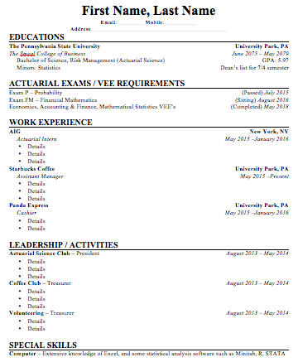
Appendix I: Blank Resume Templates & Samples
For templates blank resume templates & samples go to… http://www.psuactsci.com/career-tips.html

Slide 17
Appendix II: Additional Resources
http://www.sa.psu.edu/career/assist.shtml
http://www.events.psu.edu/cgi-bin/cal/webevent.cgi?cmd=opencal&cal=cal13
See this site for numerous events hosted by Career Services
Last Updated on 8/17/17 by Kelly Tamburo

